Slide 1
Extended Period Simulation, Water Quality Modeling and Model Calibration
Module 3
Introduction to EPANET Water Distribution Modeling
EWRI WORLD ENVIRONMENTAL AND WATER RESOURCES CONGRESS
June 5, 2018
Minneapolis, MN
Notes:
In this module, we are going to present an introduction, a brief history, and the theory behind water distribution system modeling. We will also introduce a hypothetical water distribution system called SmallWater USA that will be used as an example for most of our exercises. Before we start on the technical content of this course, we would like to do some introductions and present the logistical aspects of the course.

Slide 2
Going from Steady State to EPS
In steady state we are looking at the system at a snapshot in time. Useful for some simulations:
Sizing facilities for peak conditions
Performing some fire flow analyses, etc.
In EPS we look at the system over a period of time
Much more realistic.
Opens up a wide range of applications.
Required for water quality applications
Notes:
In steady state analysis, we are representing the system at a single point in time, i.e., a snapshot. This may be adequate for some applications such as sizing facilities under peak demand, a basic fire flow analysis, etc. When you move to an EPS analysis, you simulate the system over a period of time. Since this is much more realistic (i.e., water systems do not operate in steady state for more than a short period of time), it opens up many more opportunities, It is also required for water quality analysis.

Slide 3
Developing an EPS Model
Start with a steady state representation and ADD
Specify duration, time step and optionally, other time-related values
Provide temporal demand patterns
Specify initial conditions (e.g., pump is open)
Specify rules (controls) for pumps and valves
Additional tank info that was not mandatory or not fully specified in steady state
Notes:
When moving from a steady state model to an EPS model, you start with the steady state model and then add other input information. Added information include:
The duration of the simulation and the time step
Temporal demand patterns that define how demands change over the course of a day or other period
Rules (control) that tell the model how pumps, valves and some other components operate over time
Some additional information related to tanks that were not needed in steady state runs

Slide 4
Time Varying Demands
In steady-state you define a single demand usage (typically base demand)
In EPS you define time varying demand patterns which are multipliers of the base demand
Average demand
Demand Multiplier
Time (hours)
Notes:
In EPS modeling, variations in demand over time are represented by patterns. A pattern represents multipliers that modify the average demand (or base demand) assigned to a node. This plot shows a typical diurnal residential pattern with peak flows occurring in the morning and evening. But be careful when you talk about typical patterns since they may be very different in some areas.

Slide 5
Demand Patterns
Concept: A limited number of distinct temporal water demand patterns, each assigned to one or multiple demand nodes
Demand patterns are composed of multipliers that are applied to base demands assigned to nodes
Patterns represent different uses or different areas
Usage types (residential, industrial, etc.)
Geographic areas (pressure zones, regions, DMAs, etc.)
Water demand type (Average day, peak day, etc.)
Specific major water users
Notes:
The basic concept behind the use of demand patterns is that a limited number of temporal demand patterns can be developed and then used to calculate temporal demands for all nodes.
A demand pattern is a plot of demand multipliers over the course of a day or longer period. These multipliers are then applied (multiplied times) base demands to develop a temporal set of demands for each node. Patterns can be developed for different characteristics: types of water usage such as residential or commercial areas; geographic areas such as pressure zones or political regions; demand types such as average day or maximum day; or in some cases specific temporal patterns for individual major water users.

Slide 6
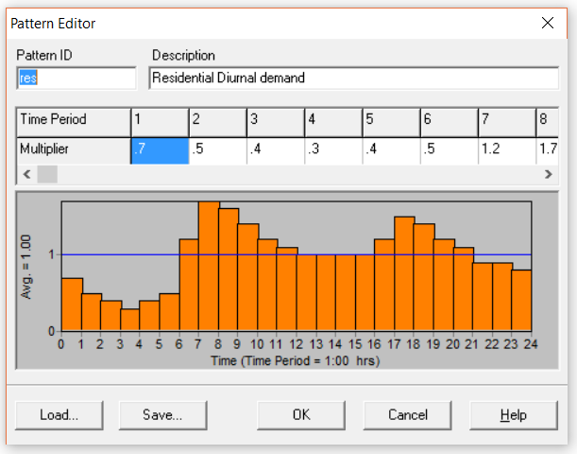
Demand Patterns
Multipliers are assigned at a fixed time interval starting at midnight or other times as defined under Options-Time
Each pattern has a unique Pattern ID
Patterns can be saved as text files (.PAT) for later loading
Notes:
Patterns are entered into EPANET by choosing patterns under Data in the Browser. Each pattern is given a unique ID and a description. A pattern is a series of multipliers at fixed time intervals. The time length of each multiplier and the starting time for the intervals are defined under Option - Time in the Browser. A pattern can be used by multiple junctions such as a pattern representing residential areas or a geographic area or by a single junction such as one representing a major water user. As will be discussed later, multiple patterns can be assigned to a specific junctions such as the case where a junction represents both a residential and commercial area. Patterns can be saved as text files (.PAT) and then later loaded into the model to define the pattern.

Slide 7
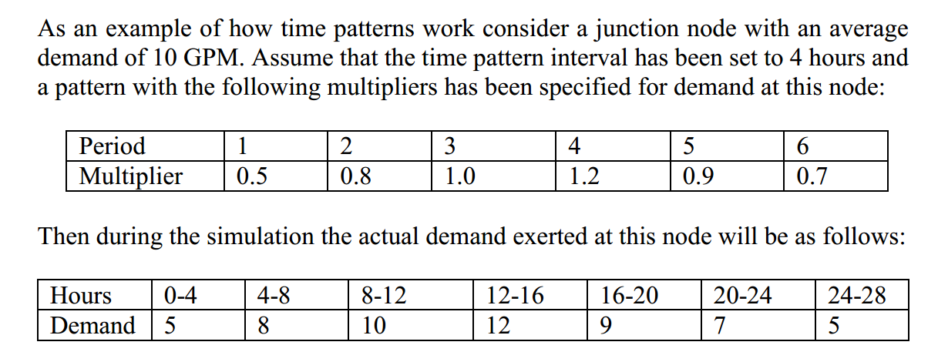
Example Use of Patterns
If the duration of the simulation exceeds the time duration of the pattern, then the pattern repeats itself.
Repeating pattern
Notes:
This slide provides an example usage of patterns. Note that if the duration of the simulation is longer than the total length of the pattern, then the pattern repeats itself. Frequently we will define a 24-hour pattern and allow that pattern to repeat for each day. If water usage varies from day to day, especially as is the case for weekends, then this can be represented by defining a 7 day (168 hour) pattern that repeats from week to week.

Slide 8
Determining Demand Patterns
Use literature values
Be careful because patterns may vary drastically by region or locally
Use information available from some water utilities
For major users, measure temporal demand patterns
Calculate temporal patterns system-wide or by DMAs or Zones
Notes:
There are various methods for determining demand patterns.
The most common is to use typical demand patterns available in the literature such as in AWWA’s M32 manual. This can be dangerous since typical curves may vary from location to location. For example, I was modeling a water system in central California and applied a typical residential pattern. However, I later found out that in that area, sprinklers are set go off at 4 AM resulting in the peak demands occurring at that time.
Some water utilities have system-wide data on usage or usage by category such as residential.
Major users such as industry may have information on temporal usage or may be willing to install meters so as to provide that information to you
SCADA data may be used to calculate system-wide or smaller area estimates of temporal water usage.

Slide 9
Calculating System-wide Usage
Flow Balance Method:
Q_{demand}
Q_{out}
Q_{in}
ΔVOL
Q_{demand} (T) = Q_{in} (T) – Q_{out} (T) - [VOL_{tank} (T) - VOL_{tank} (T-1)]
Calculate usage for each time period (T) and
normalize by dividing by average demand
Notes:
This slide shows the use of a flow-balance method that can be used in conjunction with frequently available SCADA data to define temporal patterns.

Slide 10


Calculating Usage by District Metering Areas (DMA)
DMAs are contiguous areas in distribution systems which can be separated by flow meters so that usage can be calculated for each DMA
A
B
C
Q_{in}
Q_{A}
Q_{AB}
Q_{BC}
Q_{C}
Q_{B}
ΔVOL
ΔVOL
ΔVOL
D
Q_{BD}
Q_{CD}
Q_{D}
Calculate Q_{A}, Q_{B}, Q_{C} and Q_{D} by flow balance for each time step
Notes:
In some systems, the distribution system has been divided into District Metering (or Metered) Areas (DMAs). A DMA is defined as a discrete area of a water distribution network where some boundary valves have been closed and flow meters have been installed so that water usage can be calculated for each area. DMAs are frequently used in England as part of a leak management program. Using SCADA data to access flow meter data and tank water levels, the temporal water use can be calculated for each DMA. This information can be used to define typical demand patterns for each DMA.

Slide 11
Controls (Rules)
Controls are statements that determine how the network is operated over time.
They specify the status of selected links as a function of time, tank water levels, pressures, etc. at select points within the network.
There are two categories of controls that can be used:
Simple controls
Rule-Based controls
Controls are entered in the Control section in the browser as unformatted text statements.
Notes:
In EPS, we need to tell the model how the system operates over time. This is done by a series of rules or controls that define the temporal operation of the system.
The controls specify the status or settings of links (pipes, valves, pumps) based on observed values within the network. In EPANET, teher are two types of controls: simple controls and rule based controls. Rules are input in the Control section under Data in the Browser.

Slide 12
Simple Controls
Simple controls change the status or setting of a link based on:
the water level in a tank
the pressure at a junction
the time into the simulation
the time of day
There is no limit on the number of simple control statements that can be used
Notes:
As the name implies, Simple controls are less complex rules that define the operation. Each simple control changes the status or setting for a particular link based on the four observed vaues (water level, pressure, time or time of day). There is no limit on the number of simple controls that can be used in the model.

Slide 13
Examples of Simple Controls
CONTROL STATEMENT | MEANING
LINK 12 CLOSED IF NODE 23 ABOVE 20 | Close Link 12 when the level in Tank 23 exceeds 20 ft.
LINK 12 OPEN IF NODE 130 BELOW 30 | Open Link 12 if the pressure at Node 130 drops below 30 psi
LINK 12 1.5 AT TIME 16 | Set the relative speed of pump 12 to 1.5 at 16 hours into the simulation
LINK 12 CLOSED AT CLOCKTIME 10 AM LINK 12 OPEN AT CLOCKTIME 8 PM | Link 12 is repeatedly closed at 10 AM and opened at 8 PM throughout the simulation
Notes:
Following are some examples of sim[le controls. Note that level controls are stated in terms of the height of water above the tank bottom, not the elevation (total head) of the water surface.

Slide 14
Rule-Based Controls
Rule-Based Controls allow link status and settings to be based on a combination of conditions that might exist in the network after an initial hydraulic state of the system is computed.
Expressed as a series of IF, AND, OR, THEN statements
No limit on the complexity of the compound statements
Provides wide range of freedom to formulate rules
Notes:
Rule-based controls provide the user with the ability to define more complex situations. It allows for almost unlimited Boolean type statements (IF, THEN, AND, OR). AS a result user has a very wide range of options for specifying rules. See following slide for examples.

Slide 15
Rule-Based Controls Example #1
This set of rules shuts down a pump and opens a by-pass pipe when the level in a tank exceeds a certain value and does the opposite when the level is below another value.
RULE 1 IF TANK 1 LEVEL ABOVE 19.1 THEN PUMP 335 STATUS IS CLOSED AND PIPE 330 STATUS IS OPEN
RULE 2 IF TANK 1 LEVEL BELOW 17.1 THEN PUMP 335 STATUS IS OPEN AND PIPE 330 STATUS IS CLOSED
PUMP 335
PIPE 330
17.1 ft
19.1 ft
TANK 1
Notes:
This slide shows some examples of rule-based controls

Slide 16
Rule-Based Controls Example #2
These rules change the tank level at which a pump turns on depending on the time of day
RULE 3 IF SYSTEM CLOCKTIME >= 8 AM AND SYSTEM CLOCKTIME < 6 PM AND TANK 1 LEVEL BELOW 12 THEN PUMP 335 STATUS IS OPEN
RULE 4 IF SYSTEM CLOCKTIME >= 6 PM OR SYSTEM CLOCKTIME < 8 AM AND TANK 1 LEVEL BELOW 14 THEN PUMP 335 STATUS IS OPEN
PUMP 335
12 ft
14 ft
TANK 1
Notes:
This slide shows some more examples of rule-based controls.

Slide 17
Representing Tanks in EPS
Same information required for steady-state runs
Though tank information is required for steady-state runs, some of the information is not actually used in most steady-state runs (e.g., diameter, minimum and maximum levels, volume-water level curves)
Check that tank information from steady state runs is complete and accurate to support EPS runs.
Notes:
EPS runs and steady-state runs actually require the same information to describe a tank. However, in steady-state runs, some of the required information is not actually used in the simulation. These values include diameter, minimum and maximum levels and the volume-water level curves. Thus when going from a steady state run to an EPS run, carefully check that these values have been accurately entered.

Slide 18
Uses of EPS Mode
Support of water quality modeling
Sizing water tanks
Pump operations
Energy usage
Any situation where you are trying to represent the water system over time!
Notes:
There are many uses for EPS models. Essentially any use that requires information on how the system operates over time is simulated in EPS mode. For example, a steady-state run may be adequate to determine whether a system can deliver sufficient water (at an acceptable pressure) at a given instant during a fire. However, that doesn’t check to see whether a tank is of sufficient size and properly operated to ensure that there is sufficient water in the tank for the full duration of the fire. That must be checked by an EPS run.

Slide 19
Water Quality Modeling
Flows and velocities are calculated by model. This information is used to calculate water quality.
Water quality modeling is done only in extended period simulation mode (not steady state)
Water quality modeling processes:
Transport (plug flow ignoring dispersion)
Fate:
Bulk reactions
Wall reactions
Tank hydrodynamic mixing
Notes:
Water quality simulation utilizes flow and velocity time series values generated by the hydraulic part of distribution system models.
All water quality modeling is done in extended period simulation (EPS) mode. Steady state modeling of water quality is not realistic because of the highly dynamic nature of water systems and their impact on water quality.
Water quality simulation is actually a combination of several different processes: transport, fate, and tank mixing. Transport is the movement of water quality constituents through pipes. Most models assume plug flow ignoring dispersion. In smaller pipes with lower velocities, there may actually be significant dispersion so this can introduce some error. Most models also assume that there is complete mixing when two pipes cross. Some research shows that if you have a cross where two pipes intersect, that mixing may not be complete so the complete mixing assumption may lead to some errors.
Fate is the changes in water quality constituents due to chemical, physical, or biological reactions. These reactions may occur in the flowing water and these reactions are then referred to as bulk reactions. If a reaction is caused by the interaction of the flowing water and the pipe wall then that is referred to as wall reactions.
Tank mixing refers to the movement of water while in a tank due to physical factors such as flow currents or to temperature differences.

Slide 20
Uses of Water Quality Models
Design
Checking impacts of a new tank
Adding disinfection booster station
Operation
Adjusting disinfectant feeds
Selecting disinfectant type
Hindcasting
Recreating complaints
Litigation cases
Notes:
There are many specific uses for water quality modeling. These can be categorized as uses for design, operations, and hindcasting. A few examples in the design category, are determining the impacts of a new storage tank on the water quality or adding a new disinfection booster station.
In the operations category, you can use a model to determine the impacts of changing the chlorine feed rate on chlorine throughout the distribution system. Another example in the operations area is comparing the effectiveness of adding free chlorine and chloramines.
Hindcasting is the opposite of forecasting. It is looking back in time to reconstruct historical events. Modeling may be used in the hindcasting model to reconstruct the conditions when a taste or odor complaint has been filed to try to determine the cause of the complaint. It is also frequently used in litigation cases where a water system has been contaminated in the past and the model is used to estimate which customers may have been exposed to the chemical.

Slide 21
Types of Water Quality Modeling
Water age
Source tracing
Constituents
Conservative substances
Non-conservative substances
Examples: Chlorine , DBPs
Notes:
When water quality models were first introduced through research at EPA in the mid 1980s, three forms of modeling were identified as water quality modeling: water age modeling, source tracing, and the actual modeling of constituents within the water. Some people claim that water age modeling and source tracing are not truly water quality modeling but rather they are just a characteristic of hydraulic modeling. However, that is disputed by others and based on the historic convention, we are presenting water age and source tracing as part of water quality modeling.
Constituent modeling is divided into two categories: conservative substances and non-conservative substances. Conservative substances are ones whose concentrations do not change due to reactions, while non-conservative substances are ones that do change due to physical, biological or chemical reactions. A good explanation of these differences can be demonstrated by filling a beaker with water and putting it on a window shelf for a few days. If the concentration does not change over that period, then this is considered a conservative substance. If it does change then this is a non-conservative substance. Fluoride that is added to most finished waters is generally considered to be a conservative constituent. Chlorine or disinfectant by-products such as trihalomethanes (THM), react over time and are non-conservative substances.

Slide 22
Water Age
Water age modeling is the modeling of the time history of age of water at each node
Water age is frequently used as a surrogate for water quality
new water → good / old water → bad
Age is influenced by residence times in tanks and travel times through pipes
Age is typically highest in dead ends, downstream of a series of tanks and at nodes at the far end of the distribution network
Notes:
Water age modeling results in a time series of water age values at every node in the distribution system.
Since it is generally easier to model water age than to model specific water quality constituents, in many cases, water age has been adopted as a surrogate measure of water quality. The assumption here is that water that is relatively fresh (low water age) is of higher water quality than water that is old.
Factors that affect water age include the residence time in tanks and the time it takes to travel through pipes. As a result, water age is typically oldest in: (1) dead end pipes where the velocity is usually quite low; (2) downstream of a tank or series of tanks; and (3) at the far ends of the water system (locations that are farthest from the treatment plants).

Slide 23
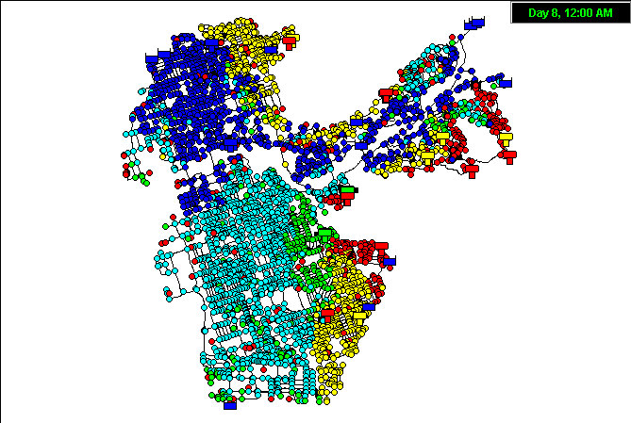
Maximum Water Age
Notes:
This plot is an output map from EPANET showing the maximum water age at each node in the system. The blue and light blue nodes represent nodes with relatively low water age < 2 days). Those nodes are typically served directly from one or more of the sources. Green and yellow nodes are areas with moderate water age (2 to 7 days). In most of these cases, water has spent time in storage tanks before reaching the customer. Red nodes represent areas with high water age (> 7 days). This is usually caused by water that has gone through a tank and/or a series of tanks that have not been sufficiently “exercised” (insufficient inflow and outflow periods) resulting in long residence times.

Slide 24
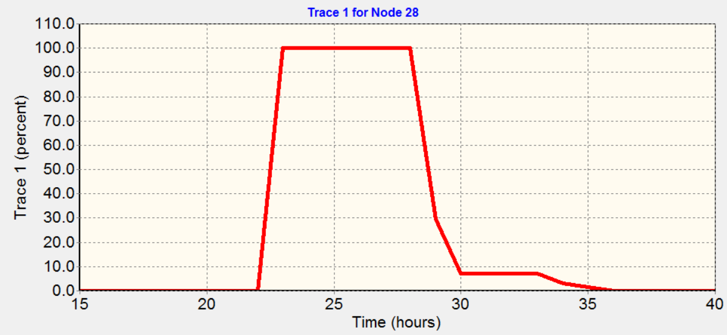
Source Tracing
Relevant to water systems with multiple sources
Tracing % of water coming from a single source to all points in the distribution system over time
Multiple runs needed to trace multiple sources
Notes:
When a water system has 2 or more sources of water, it is frequently of interest to see which areas are served from each source. It is generally recognized that customers are most sensitive to changes in characteristics of the water that they receive. So if they generally receive water from treatment plant A, and then sporadically receive their water from treatment plant B which may taste very differently, they are most likely to complain when the water comes from treatment plant B, even if the water quality is better than treatment plant A. The source tracing feature allows us to calculate the percentage of water coming from a designated source to all nodes in the distribution system. In order to trace multiple sources, separate runs must be made for each source. So, two model runs are required to trace water from treatment plant A and from treatment plant B. as is the case with water age modeling, source tracing is totally dependent on the hydraulic modeling of the system. There are no specific input parameters that can be adjusted when tracing sources so the validity of source trace modeling depends solely on the validity of the hydraulic model.

Slide 25
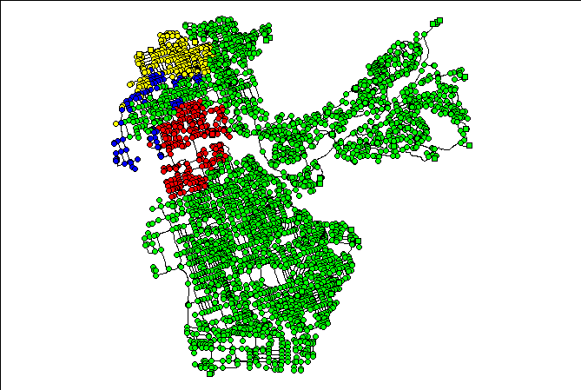
Source Water Tracing (based on 3 separate runs)
WTP
Demineralization Plant
Wells
Notes:
This map of the same California water system used previously, shows the results of three source tracing runs of the model. The green nodes are ones that receive a majority (> 50%) of their water from the water treatment plant; the yellow nodes are ones that receive a majority of their flow from the wells; the red dots receive a majority of their water from the demineralization plants; and the blue dots are ones that receive water from all three sources.

Slide 26
Constituent Modeling
Simulate the concentration of constituents in water at all points in the distribution system
Conservative substances: Concentration of conservative substances only affected by mixing (for example, fluoride)
Non-conservative substances: Concentration changes due to growth or decay
Chemical, biological & physical processes
Represented by different mathematical transformations
Notes:
The third type of water quality modeling is constituent modeling. In this type of modeling the concentrations of selected substance are calculated at each node over the time history of the model run. As discussed previously, conservative substances are ones that do not react and as a result, changes in concentration are due solely to dilution and mixing of waters. Fluoride and other inert substances are generally considered to be conservative though even those can sometimes change concentrations due to physical reactions with pipes. Non-conservative substances experience chemical, biological or physical reactions and therefore change concentration as they move through the distribution system. The reactions of non-conservative substances can be calculated by various mathematical equations describing the transformations.

Slide 27
Water Quality Processes in Pipes
Source: Center for Biofilm Engineering, MSU, Bozeman
Notes:
This picture prepared by the Center for Biofilm Engineering at Montana State University illustrates some of the processes that occur as water moves through pipes. Many of these processes are not fully understood and detailed information on specific pipes within a distribution system is usually lacking. Water quality models use simplified methods for representing these processes.

Slide 28
Modeling Non-Conservative Substances
Non-conservative constituents that are frequently modeled
Chlorine & chloramines
DBPs (Trihalomethanes)
Most common types of transformations
First order decay
Zero order growth or decay
First-order growth to equilibrium
Notes:
Non-conservative constituents that are most commonly modeled relate to the disinfection process. They include modeling of the disinfectant (chlorine or chloramines) and the by-products of disinfection such as trihalomethanes. For disinfectants, water utilities are interested in maintaining an adequate level of disinfectant throughout the distribution system so that the water is safe from pathogens that are generally controlled by adequate disinfectant levels. For DBPs, the concern is with keeping disinfection by-products, that tend to grow after water leaves the treatment plant, to an acceptable and safe level.
There are three general types of transformations that are supported by EPANET and other water distribution system modeling software: first order decay; zero order decay or growth; or first order growth to a limiting equilibrium value.

Slide 29
Chlorine Modeling
Most common water quality constituent modeled
Predict the chlorine residual throughout the distribution system
Can vary significantly during the day
Notes:
The most common constituent that is modeled in distribution systems is chlorine. Chlorine can vary significantly both over time and location. For example, it is not uncommon for the chlorine to vary over a large range at a single location over the course of a day or to vary over a large range from one location to another.

Slide 30
Bulk Decay
Bulk decay: decay in flowing water
Usually represented as first order decay C_{t} = C₀ e^{-kt}
Decay rate
depends on water quality characteristics
independent of pipe material
Negative sign for k indicates decay
Range of decay coefficients: -0.05 to -15 per day
Equivalent to half life of 14 to 0.05 days
Most typical range is -0.2 to -1.0 per day
Equivalent to half life of 3.5 to 0.7 days
Notes:
Bulk decay is the decay that takes place in the flowing water in the distribution system. An example of bulk decay occurs when you take a cup of water and put it on the water sill. If you measure chlorine at the start of the experiment and then take it a few days later, the change in chlorine concentration is due to bulk decay.
Bulk decay is usually represented as a first order (exponential) decay.
The decay rate is purely a function of the water quality characteristics and is independent of the pipe material.
Remember that the decay coefficient is entered as a negative value. If you forget and use a positive value in the model, you will see chlorine concentrations increasing over time.
The range of possible values for the decay coefficient is vary wide so it is important to do some laboratory analysis to determine the bulk decay coefficient.

Slide 31
Wall Decay
Wall decay: Interaction of water with wall
Due to corrosion, biofilm, and other processes at the wall
Depends on pipe material
Rate of loss of chlorine at wall depends upon
wall decay coefficient
rate at which mass is transferred to the wall
The wall decay coefficient can be determined from literature values or through field studies.
Generally not a factor in tanks & reservoirs
ratio of wall to volume is usually very small
Notes:
Wall decay is a lot more difficult process to model. Wall decay is the loss of chlorine due to the contact of the flowing water with the pipe wall. There are several processes such as corrosion and biofilms that occur at the wall. Wall decay is primarily a function of the pipe material and its condition rather than the water quality characteristics of the flowing water. The rate of loss at the wall depends upon the wall decay coefficient and the rate at which the water contacts the wall. Wall contact increases with the turbulence of the flow and increases with smaller pipe diameters. When you think about this, it makes sense. Wall decay is generally not a factor in tanks.

Slide 32
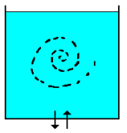
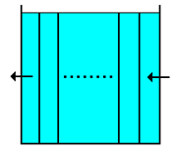
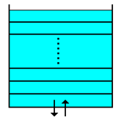
Modeling Tank Mixing
Tank mixing represented by 4 alternative theoretical mixing models
No tanks operate exactly as one of the theoretical models
Main Zone
Inlet-Outlet Zone
Complete Mix
Plug Flow FIFO
Plug Flow LIFO
Two Compartment
Notes:
EPANET contains four separate simplified models for representing mixing in a tank:
Complete mix: the tank is instantaneously and completely mixed at all times. Is this physically possible?
Plug flow: First in, first out or FIFO. It is like a line of soldiers marching in one side of the tank and marching out the other side. This is most common in a clearwell or contact chamber where you are trying to achieve a constant contact time.
Plug flow: Last in, first out (LIFO). This can approximately occur in a tank with a single combined inlet-outlet where there is little momentum cause mixing. As a result, the last water to enter the tank is the first water to leave it.
Two compartment model: Each theoretical compartment model is completely mixed and there is interchange between the two compartments. A single parameter is required representing the fraction of the tank in the inlet-outlet compartment. There is no guidance on what to use for this parameter and ths model is very rarely used.

Slide 33
Running a Water Quality Model
Start with calibrated hydraulic EPS model
Select the total duration of the run
Select the parameter to be modeled (Age, trace or constituent)
For trace and non-conservative constituents, define required parameters
For each tank, choose a mixing model
Define source concentrations
Set initial conditions
Run the model and look at results
Notes:
This slide summarizes the 8 steps that are followed in running a water quality simulation of a distribution system.

Slide 34
What is Calibration?
Compare model results to field sampling data
Pressure testing
Fire Hydrant tests
SCADA data
Water quality measurements
Adjust model parameters so that model results more closely represent observed results
Necessary step to develop confidence in model results
Notes:
Calibration is the process of comparing modeled results to actual operational data and adjusting model components to better reflect the actual results. Hydraulic models are mathematical representations of the water distribution system and are subject to large variations in results depending on the data used in the model. For example, many models are developed with uniform c-values. This may be okay for new construction, but in water systems that have mains that could be over 100 years old it may not be an accurate representation of roughness coefficients. Thats where calibration plays a vital role in adjusting the model components to reflect the actual system.

Slide 35
Steady-State and EPS Calibration
Steady-state calibration
Use of targeted field tests
Using fire flow data
Specific pressure tests
C-value testing
Flow tests to confirm demand
EPS calibration
Calibrating an entire area (system or pressure zone) to recorded data captured by SCADA or other methods
Comparing overall system performance to model results
Using SCADA
Wide-scale field studies
Notes:
Macro calibration is comparing the overall system performance in terms of SCADA and limited field testing to the model results. Micro calibration takes this effort one step further and compares extensive field testing, such as pressure and flow tests and compares it to the model results. Adjustments of model parameters, such as demand patterns, roughness coefficients, are made as a result of these tests.

Slide 36
Validation
Calibration only ensures that the model matches a specific set or sets of field data.
In validation you apply the calibrated model to a different scenario (i.e., an independent data set) and check that the calibrated model parameters apply to other scenarios
Use an existing “calibrated” model and create a new scenario from it. Needs less effort to “calibrate” the new scenario.
For example: Start with an average day model and create a maximum hour scenario
Notes:
Validation is when you take an existing calibrated model and create a new scenario, for example, taking a maximum day calibrated model and creating an EPS fall day. This would require changing demands by some proportionality value and using that value as a Demand Multiplier. You would then want to compare initial settings and controls with the SCADA, but the calibration effort should be considerably less than the initial effort simply by editing these inputs.

Slide 37
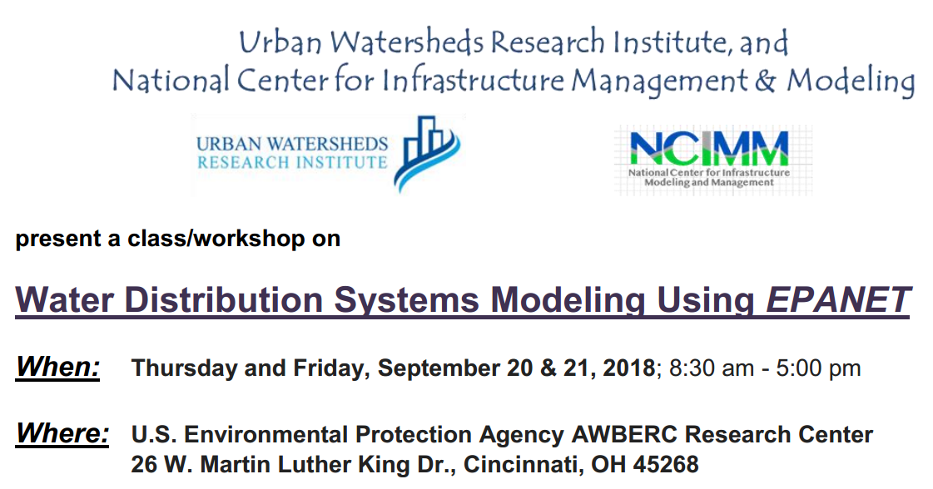

Slide 38
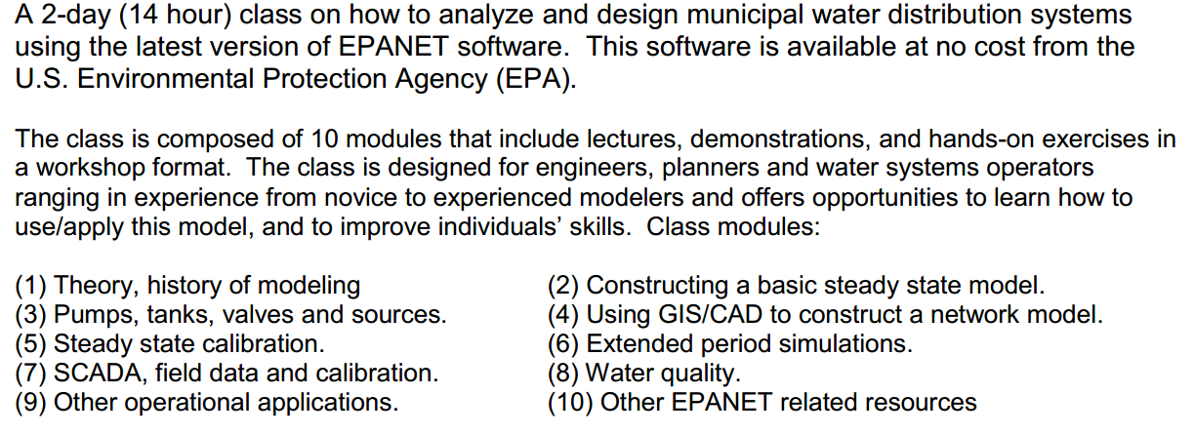
About this Class:
https://www.regonline.com/EPANET-Intro2018

Slide 39
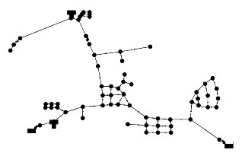
SmallWater USA
Simple hypothetical model
Population: 2700
Pipe material: cast iron, A-C, PVC
Two sources
Primary: Surface water purchased
Secondary: Well field
Two tanks:
50,000 gal elevated tank & 165,000 gal standpipe
Water usage: Avg. 210,000 gpd; Max 400,000 gpd
Three pressure zones: main, high & reduced
Notes:
First, we want to familiarize you with the water distribution system, SmallWater USA, that you are going to use for this exercise.
This is a small, realistic, hypothetical water distribution system serving 2700 people that we will use for our exercise.
The hypothetical system was developed over time resulting in three different pipe materials (old cast iron, some asbestos-cement pipe, and PVC in the newer parts of town).
There are two sources: a well field that was the original source and now used as a secondary source of water; and an inter-connect with a larger water company that provides surface water and is now the primary source of water.
There are two tanks: a newer elevated tank with a capacity of 50,000 gallons; and an older 165,000-gallon standpipe.
Average consumption is 210,000 gallons per day. Maximum day usage is 400,000 gallons per day.
There are three pressure zones: the main pressure zone encompassing most of the town; a high zone north of town that served by a pump station; and a reduced zone that is served by a PRV from the high zone.

Slide 40
TANK
N
Land Use Category
High Zone
Residential
PRV
PUMP
Industrial
Commercial
Shopping Center
School
New Subdivision
Reduced Zone
Trailer Park
PUMP
TANK
(Standpipe)
Industrial Park
Well Field
Old Subdivision
PUMP
Inter-Connect
Notes:
This map shows the three zones, the land use (residential, industrial and commercial) for the town, and the pressure zone boundaries.The town has two sources of water, an interconnect with a nearby city, and a well field. The interconnect is the primary source of water. Like many small to medium systems, SmallWater USA expanded over time. New areas and zones were built and water components added to accommodate these new areas. At the present time there are three pressure zones: the original zone along with a high zone built on higher ground north of the main zone, and a “reduced zone” located on lower ground adjacent to and fed from the high zone.

Slide 41
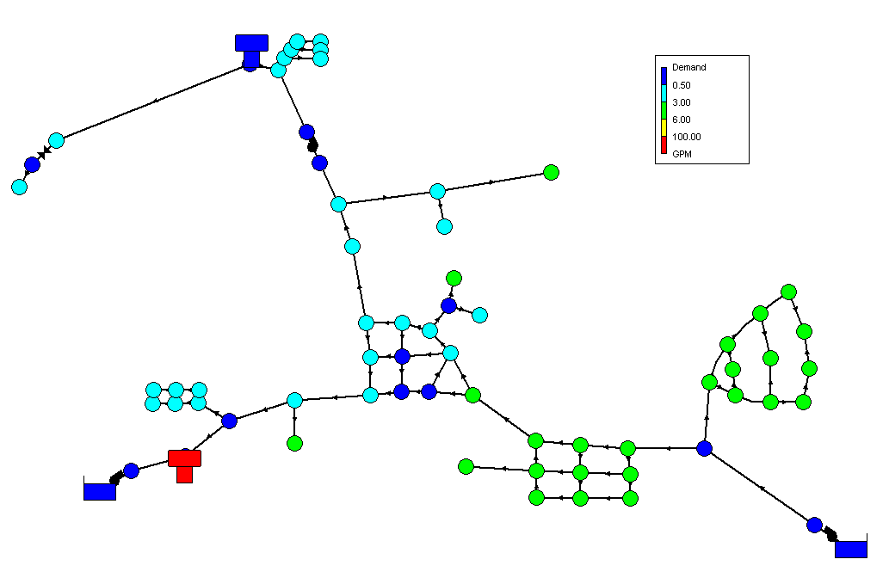
Average Demand (gpm)
50,000 gal
Elevated Tank
165,000 gal
Standpipe
Notes:
This plot produced by EPANET shows the average water demand by node grouped as: less than 0.5 gallons per minute (GPM), 0.5 to 3 GPM, 3 to 6 GPM, 6 to 100 GPM, and greater than 100 GPM. Remember that 1 GPM is the equivalent of 1440 gallons per day, and that 1 million gallons per day (1 MGD) is the equivalent of 694 gallons per minute.

Slide 42
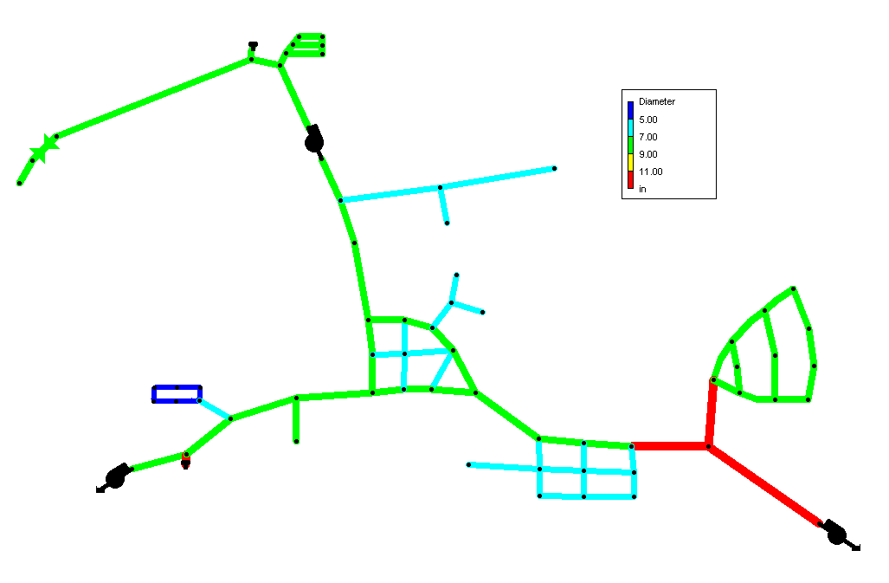
Pipe Diameters (in)
Notes:
This plot produced by EPANET shows pipe diameters. The dark blue pipes are 4” in diameter, light blue pipes are 6”, green pipes are 8”, and red pipes are 12’ diameter pipes. There are no yellow pipes with diameters in the range of 9” to 11”.

Slide 43
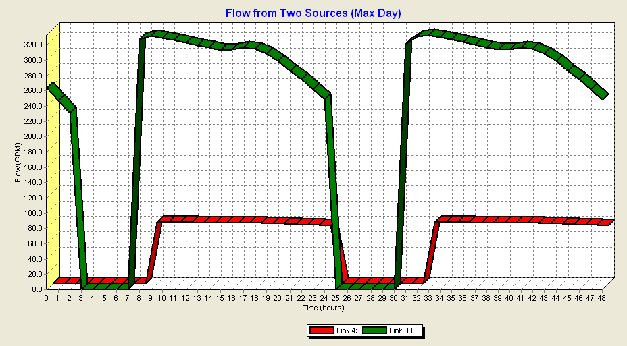
Notes:
This plot produced by EPANET shows the flows from the two sources over a 48 hour period. The green line is the flow from the inter-connect while the red line shows the water used from the well field. The pumps that control flows from the two sources are controlled by the water level in the standpipe. This plot shows operation during maximum day usage. During average day usage, the well fields are not used.
The pump that provides water to the high zone is controlled by the water levels in the elevated tank.

Slide 44
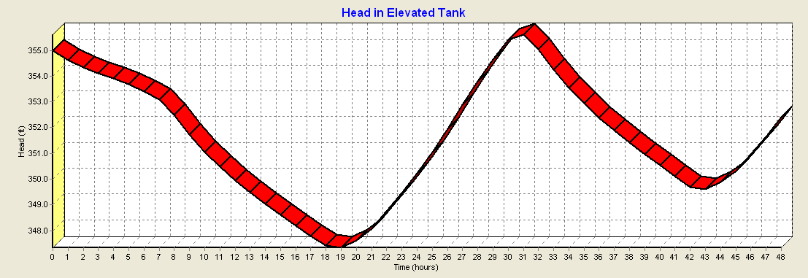
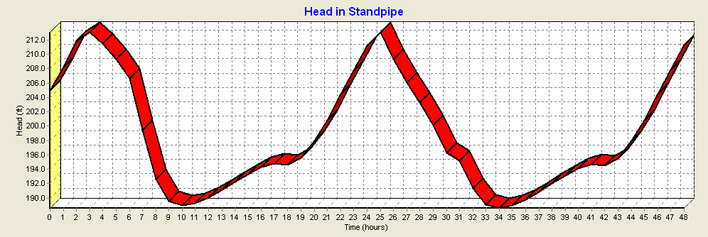
Notes:
This plot produced by EPANET shows the head (water levels referenced to mean sea level) in the two tanks. As illustrated, the elevated tank cycles over a range of about 7 feet while the standpipe cycles over a larger range of about 22 feet.

Slide 45
EPANET
A Very Brief Quick Start Hands-on Orientation Using Model of SmallWater USA
Input file: SmallWater-quick start demo.net
Notes:
Time to open up your computers and play around with an EPANET model of SmallWater USA. This will give you a Quick Start feel for EPANET. Don’t worry about the details. We will cover everything in more detail later in this course. If you prefer to just watch that is OK also.

